Slide 1
20241116 F22 RUN S07 STEP.5 MFC-01 ALARM issue

Slide 2
Discipline 1. 選定團隊 Form the Team
S210
S220

Slide 3
Discipline 2.描述問題及現況掌握Describe the Problem
(WHO detected the problem? WHAT is wrong? State the problem in terms of object and defect. WHERE the problem was first detected, describe location of the detection, lot #, WHEN and HOW it was detected)
What | 2024/11/16 F22 RUN S07 STEP.5 MFC-01 ALARM issue 產品厚度(Å) slot-1 C1/C4/C6: 221/217/225 OOS(SPEC:200+/-20)
Where | F22
When | 2024/11/16
Extent | Impact 6 lots/150pcs

Slide 4
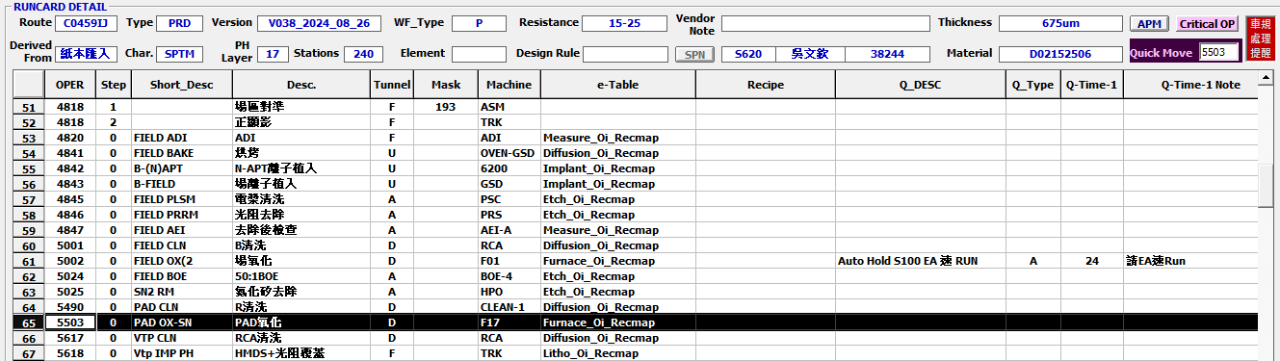
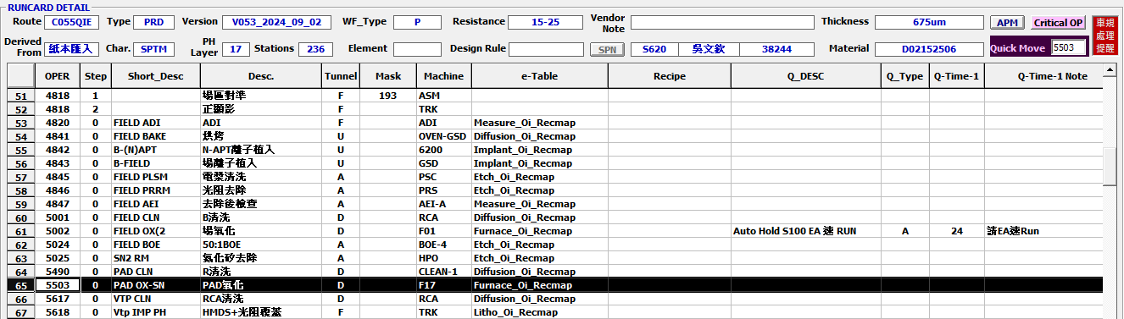
Runcard

Slide 5
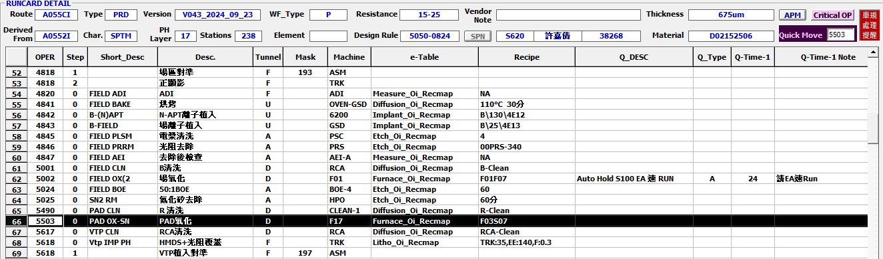
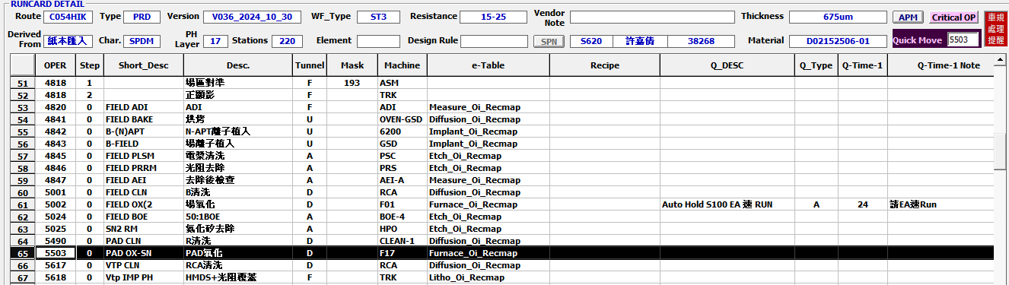
Runcard

Slide 6
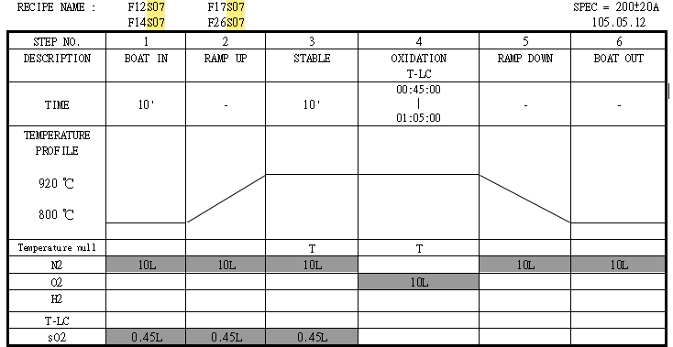
Discipline 2.描述問題及現況掌握Describe the Problem
(WHO detected the problem? WHAT is wrong? State the problem in terms of object and defect. WHERE the problem was first detected, describe location of the detection, lot #, WHEN and HOW it was detected)
異常點
Step.5 8分鐘未通N2，造成殘存O2與Si繼續反應。

Slide 7
Discipline 2.描述問題及現況掌握Describe the Problem
(WHO detected the problem? WHAT is wrong? State the problem in terms of object and defect. WHERE the problem was first detected, describe location of the detection, lot #, WHEN and HOW it was detected)
RMS check : step.5 降溫步驟alarm,溫度皆正常。
設定溫度
實際溫度

Slide 8
Discipline 2.描述問題及現況掌握Describe the Problem
(WHO detected the problem? WHAT is wrong? State the problem in terms of object and defect. WHERE the problem was first detected, describe location of the detection, lot #, WHEN and HOW it was detected)
RMS check gas flow :N₂流量異常
設定流量
實際流量
N2
O2
T-LC
N2
O2
T-LC
Step.5 約8分鐘未通N2

Slide 9
產品確認 : 量測C1到C6厚度， C1/C6 OOS
Discipline 3.執行及驗證暫時防堵對策 Contain the Problem
(Define and implement containment actions to isolate the effect of problem from any internal/external customer until corrective action is implemented)
Action: (1) C6 24452420 取#1 做C clean 後再確認厚度是否合規格。
(2) 其他批待 C6 24452420 #1 確認完厚度再行補RUN C-clean。

Slide 10
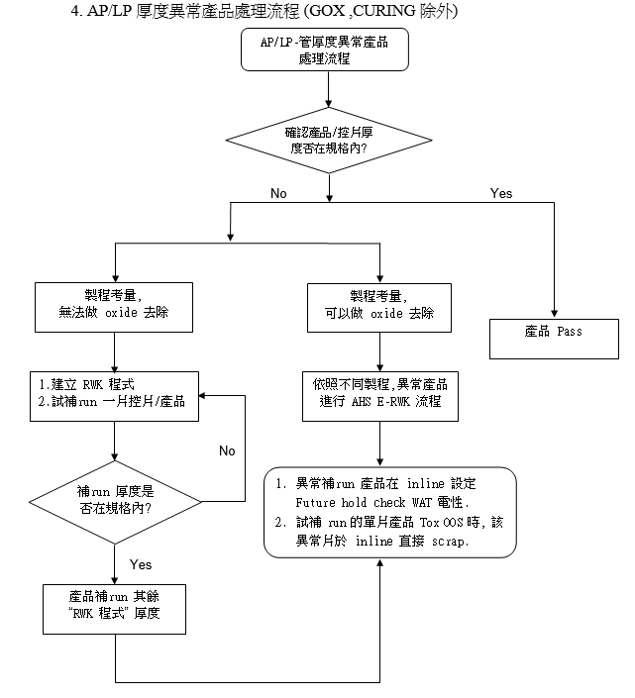
OCAP

Slide 11
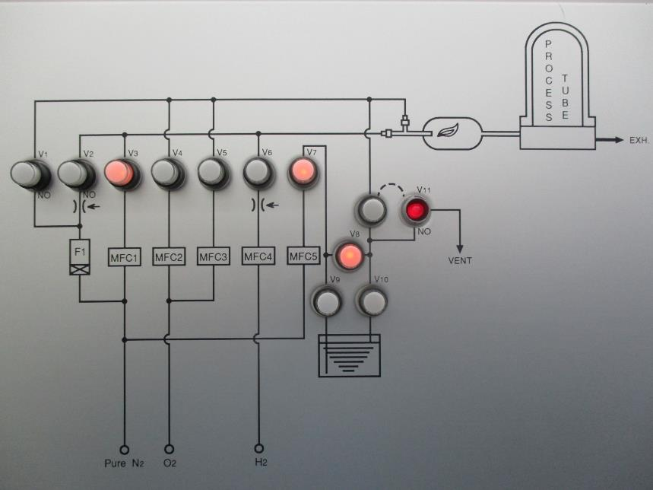
Discipline 3.執行及驗證暫時防堵對策 Contain the Problem
(Define and implement containment actions to isolate the effect of problem from any internal/external customer until corrective action is implemented)
EQ check：
1. Check MFC-01 後方 V3 valve 電磁閥無給氣，其餘管路正常。
故 MFC-01 (N2) 無流量，約10分鐘後恢復正常。
V3 valve

Slide 12
Discipline 3.執行及驗證暫時防堵對策 Contain the Problem
(Define and implement containment actions to isolate the effect of problem from any internal/external customer until corrective action is implemented)
2. Check RMS step-5於23:14~23:24 約10min MFC-01無通N2,於24:27 恢復正常。

Slide 13
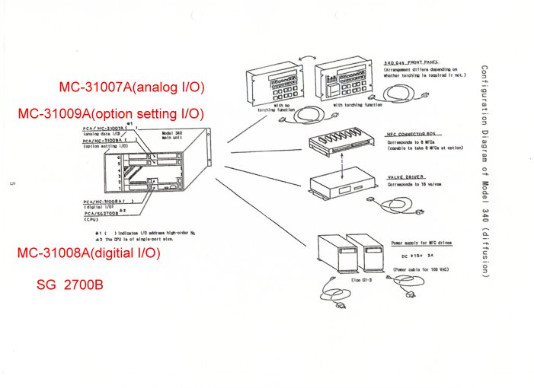
3. 量測 V3 電磁閥無 DC+24V，其餘電磁閥 DC+24V normal
4. 空run test S07 now , follow test run 3次 check 是否會再發生
MC-31008-01 PCB
Issue parts
MC-31007A(analog I/O)：類比訊號介面，用於如MFC 控制。
MC-31008A(digital I/O)：數位訊號介面，用於如VALVE、FRONT PANEL控制。
MC-31009A(option set I/O)：操作設定介面，亦與APC DRIVER控制有關。
SG 2700B(cpu)：如電腦CPU一樣為M340大腦，用以訊號運算處理。將M340各項訊號資料傳至3100(3200)，作為與3100(3200)面板的訊號傳輸橋樑。

Slide 14
Summary
2024/11/16 F22 RUN S07 STEP.5 MFC-01 ALARM issue
Step5. 8分鐘未通N2，造成產品厚度偏厚OOS。
產品確認 :
Action: (1) C6 24452420 取#1 做C clean 後在確認厚度。
(2) 其他批待 C6 24452420 #1 確認完厚度再行補RUN C-clean。 設備確認
(1) Check MFC-01 之V3 valve 無給氣,其餘管路正常。 (2) Check M340 controller 之SG-2700 PCB及MC-31008 PCB 燈號控制正常。

Slide 15
Discipline 3.執行及驗證暫時防堵對策 Contain the Problem
(Define and implement containment actions to isolate the effect of problem from any internal/external customer until corrective action is implemented)
3.1 異常產品 (Defect Lots)
項目 Item | 處理方式 Action | 負責人員 Resp | 預定完成日 Due | 實際完成日 Imp. | 處理結果 Verification
3.2 波及產品 (Impact Lots)
項目 Item | 處理方式 Action | 負責人員 Resp | 預定完成日 Due | 實際完成日 Imp. | 處理結果 Verification

Slide 16
Discipline 3.執行及驗證暫時防堵對策 Contain the Problem
(Define and implement containment actions to isolate the effect of problem from any internal/external customer until corrective action is implemented)
3.3 波及設備 (Impact Machine)
項目 Item | 處理方式 Action | 負責人員 Resp | 預定完成日 Due | 實際完成日 Imp. | 處理結果 Verification
N.A | N.A | N.A | N.A | N.A | N.A
3.4 波及製程 (Impact Route) : 是(YES)/否(No)
項目 Item | 處理方式 Action | 負責人員 Resp | 預定完成日 Due | 實際完成日 Imp. | 處理結果 Verification
N.A | N.A | N.A | N.A | N.A | N.A
3.5 產品召回選項，是否需進行客戶端波及產品的召回?是(YES)/否(No)
Customer | Product No. | Lot number / Wafer number | Approx. Quantity
N.A | N.A | N.A | N.A

Slide 17
Discipline 4.定義及驗證真因 (Identify the Root Cause)
(Identify all potential causes which could explain why the problem occurred)
4.1 Non-conformance root cause (defect nature / technical root cause):
c) 真因驗證 (Root Cause Verification)

Slide 18
Discipline 4.定義及驗證真因 (Identify the Root Cause)
(Identify all potential causes which could explain why the problem occurred)
4.1 Non-conformance root cause (defect nature / technical root cause):
d) 5-Why analysis
b) Conclusion :

Slide 19
Discipline 4.定義及驗證真因 (Identify the Root Cause)
(Identify all potential causes which could explain why the problem occurred)
4.2 Non-detection / escape root cause (Provide reason to why the current system failed to detect)
a) 5-why:
b) Conclusion

Slide 20
Discipline 5.擬定及驗證永久改善對策Choose and verify permanent corrective action (列出各項執行之對策並檢核其對策有效性)
5.1 What was the chosen corrective action to correct the root cause? (Add photo or diagram where applicable.)
Short term :
Long term:

Slide 21
Discipline 5.擬定及驗證永久改善對策Choose and verify permanent corrective action (列出各項執行之對策並檢核其對策有效性)
5.1 What was the chosen corrective action to correct the root cause? (Add photo or diagram where applicable.)

Slide 22
Discipline 5.擬定及驗證永久改善對策Choose and verify permanent corrective action (列出各項執行之對策並檢核其對策有效性)
5.2 Verification of actions effectiveness

Slide 23
Discipline 5.擬定及驗證永久改善對策Choose and verify permanent corrective action (列出各項執行之對策並檢核其對策有效性)
5.2 Verification of actions effectiveness

Slide 24
Discipline 6.實施認永久改善對策Corrective Actions Implementation
6.1 For non-conformance root cause (defect nature / technical root cause):
6.2 For non-detection / escape root cause

Slide 25
Discipline 7.避免再發Prevent Recurrence (Modify System / Document)
7.1 Systemic Actions:

Slide 26
Discipline 7.避免再發Prevent Recurrence (Modify System / Document)

Slide 27
Discipline 7.避免再發Prevent Recurrence (Modify System / Document)
7.2 Corrective Actions Fan-out: (水平展開):

Slide 28
Discipline 8. Congratulate the Team
Thanks for every member helped in this case.
Reviewed and Approved by:

